Slide 1
Array

Slide 2
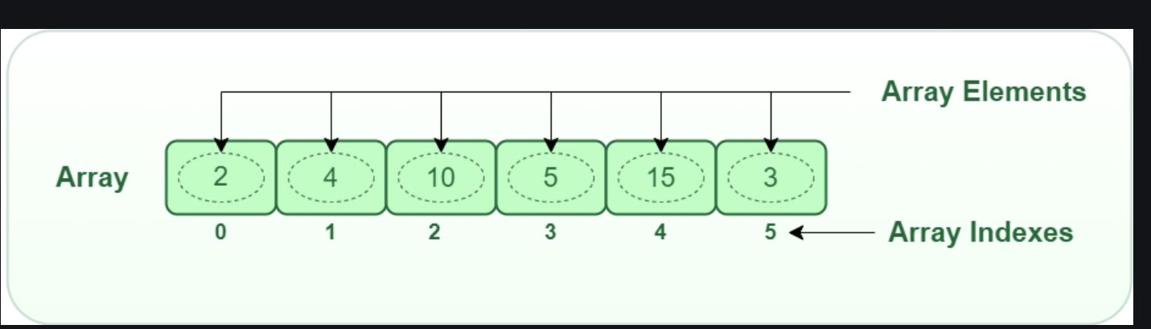
What is an Array?
An array is a collection of items of same data type stored at contiguous memory locations.
Array

Slide 3
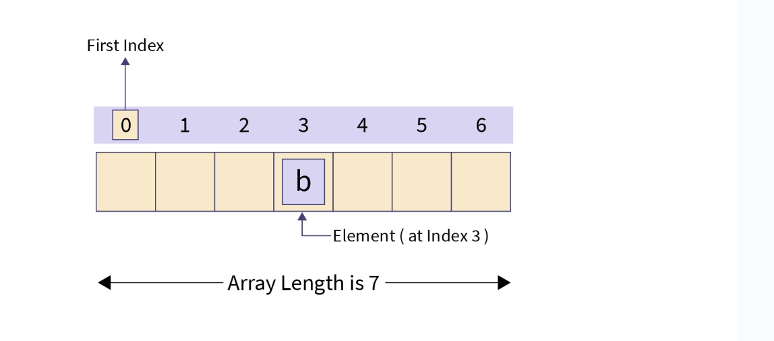
A one-dimensional array in Java is a collection of similar types of elements stored at contiguous memory locations.
The data is stored in a continuous manner, which makes operations like search, delete, insert etc., much easier.
Array

Slide 4
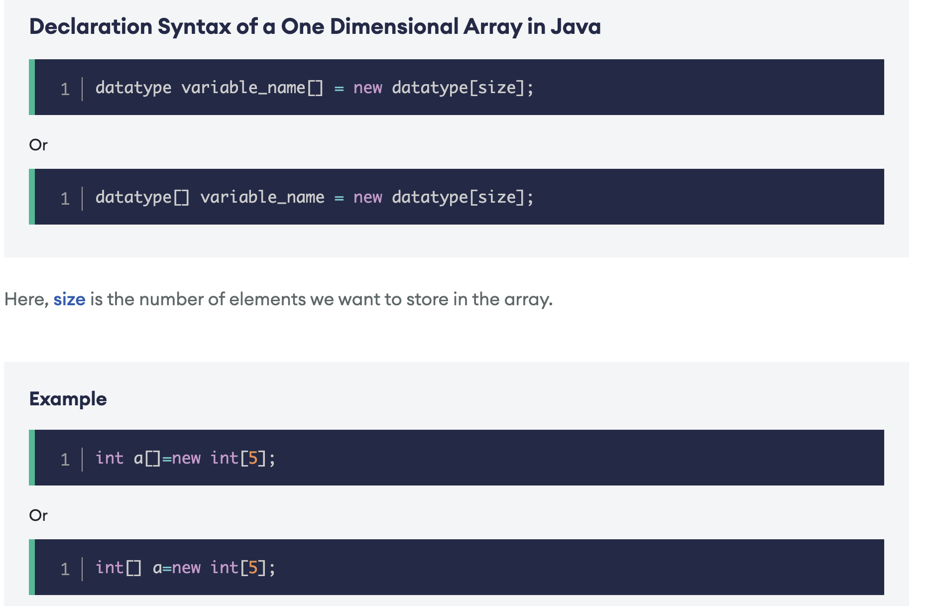

Slide 5
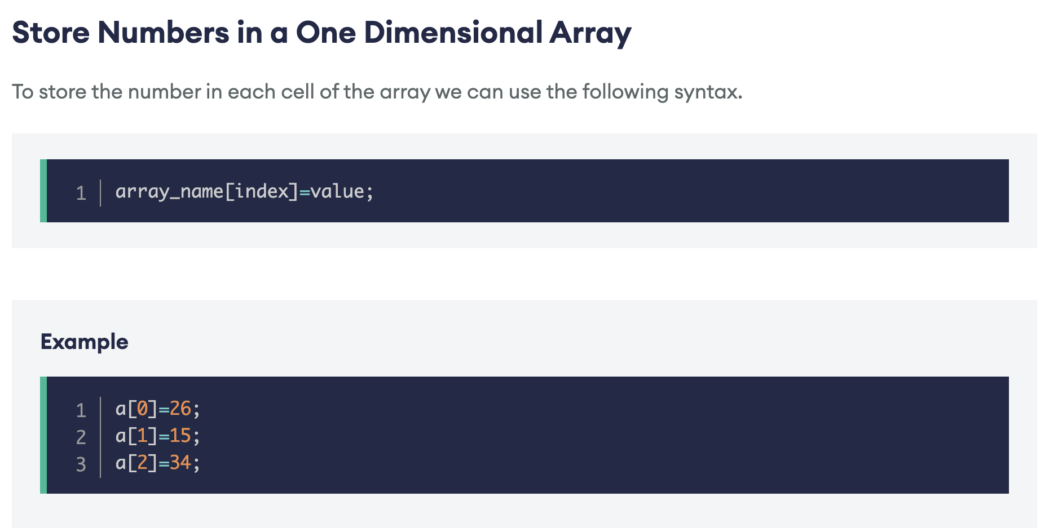

Slide 6
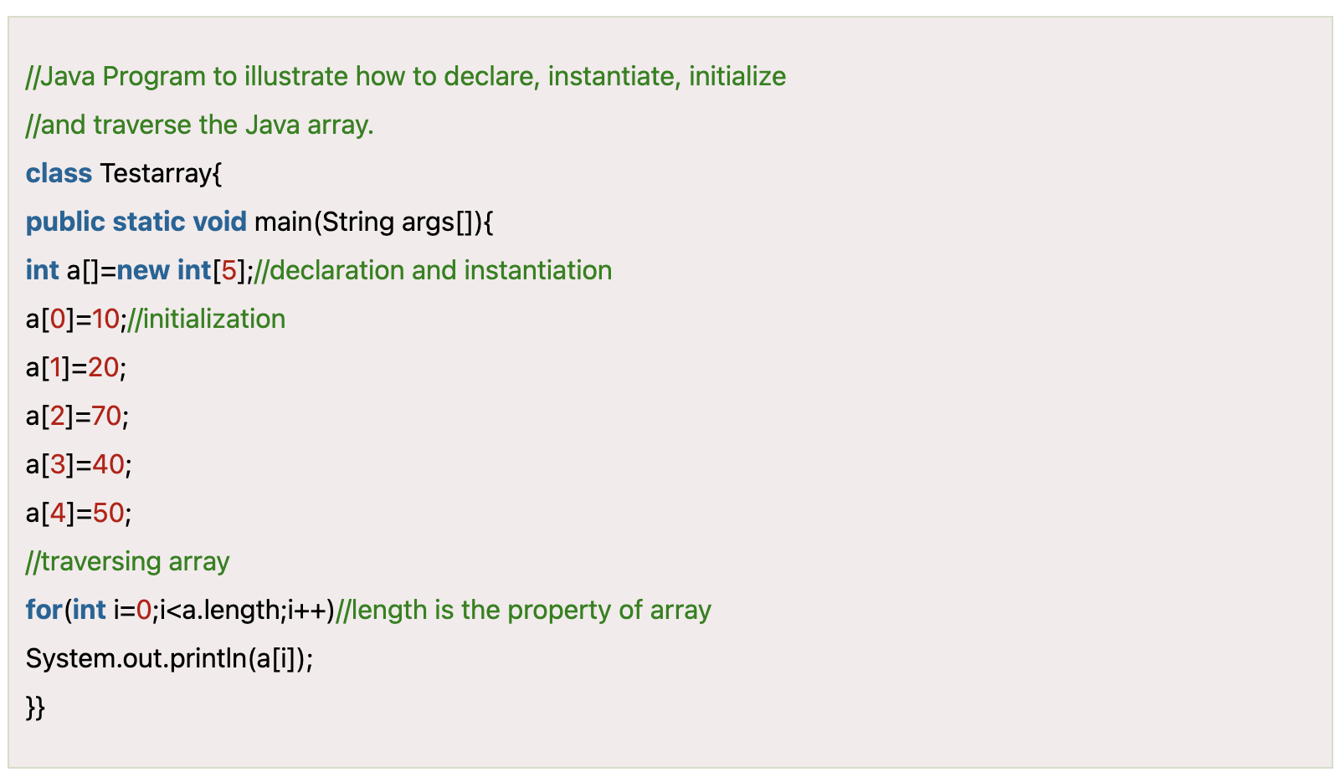

Slide 7
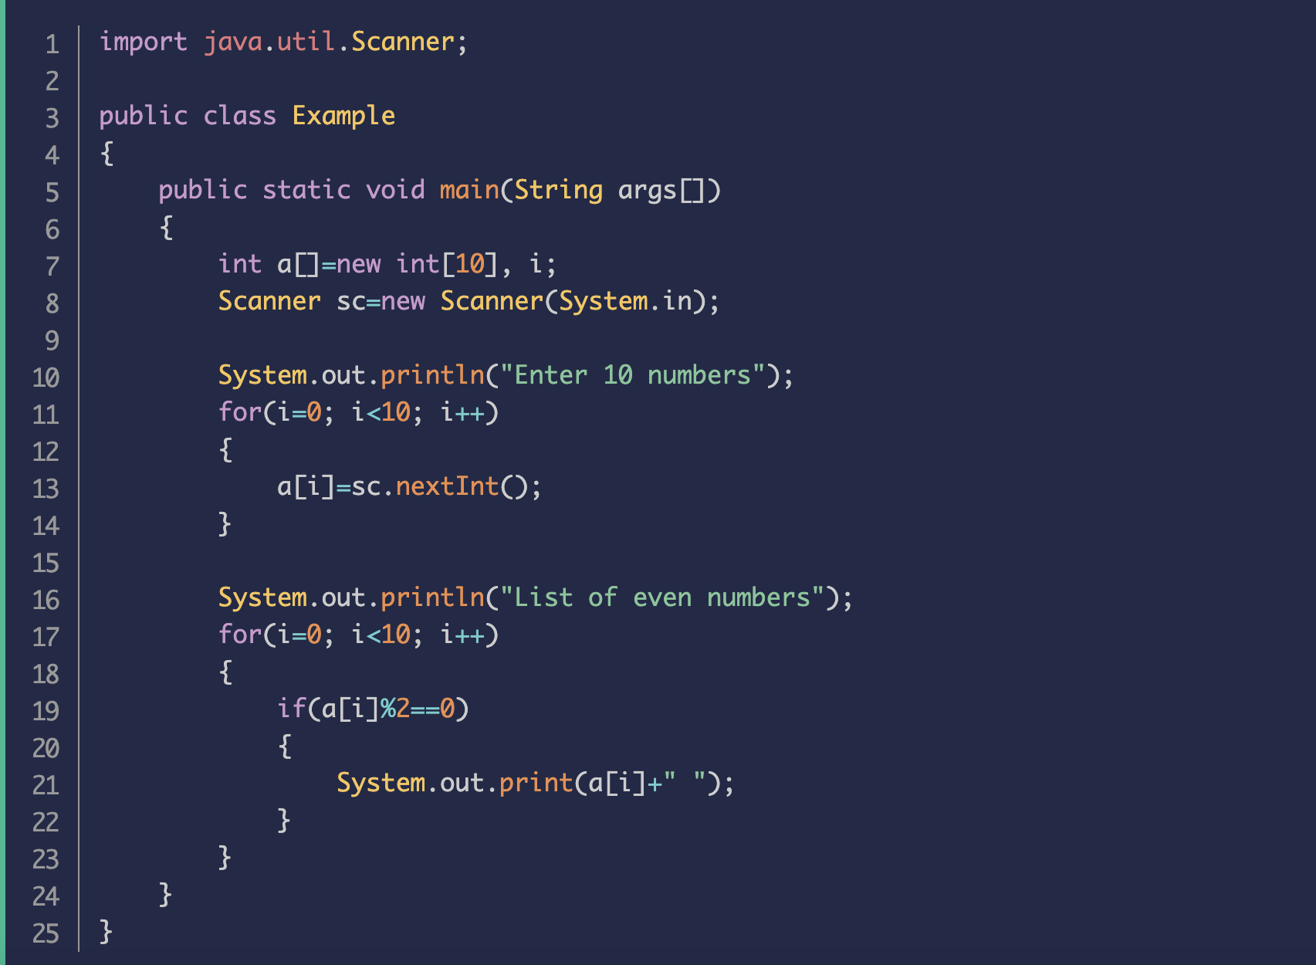

Slide 8
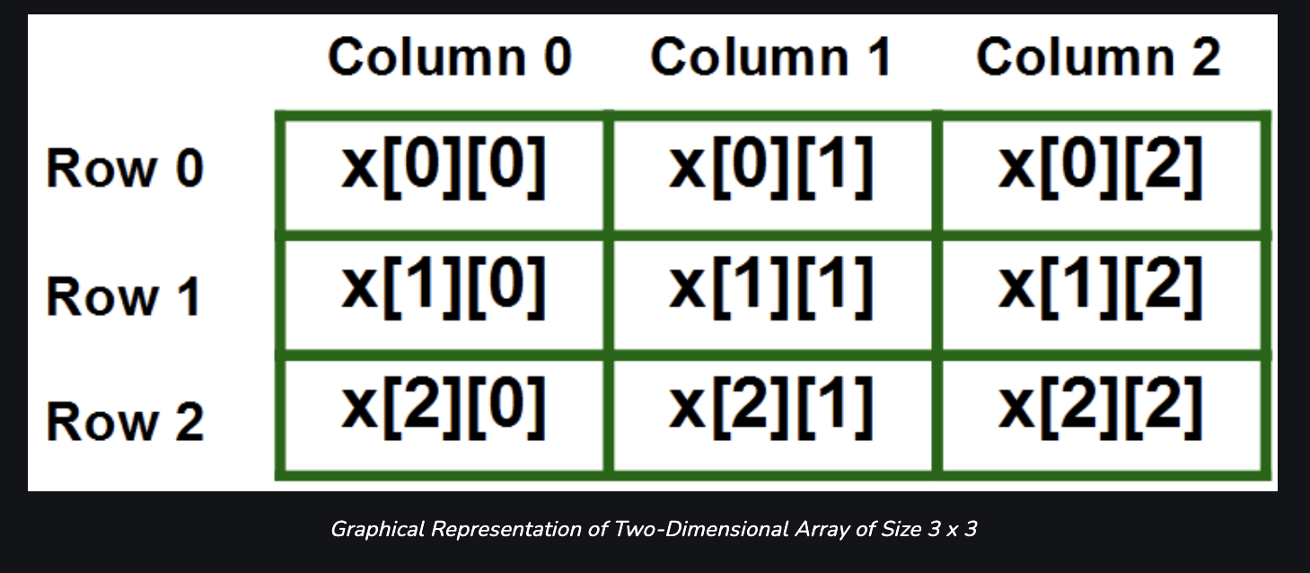
Two-Dimensional Array in C
A two-dimensional array or 2D array in C is the simplest form of the multidimensional array.
We can visualize a two-dimensional array as an array of one-dimensional arrays arranged one over another forming a table with ‘x’ rows and ‘y’ columns where the row number ranges from 0 to (x-1) and the column number ranges from 0 to (y-1).

Slide 9
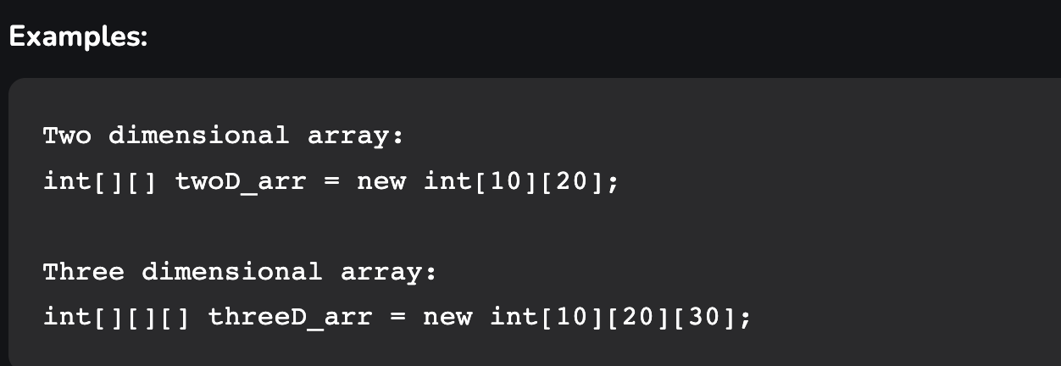

Slide 10
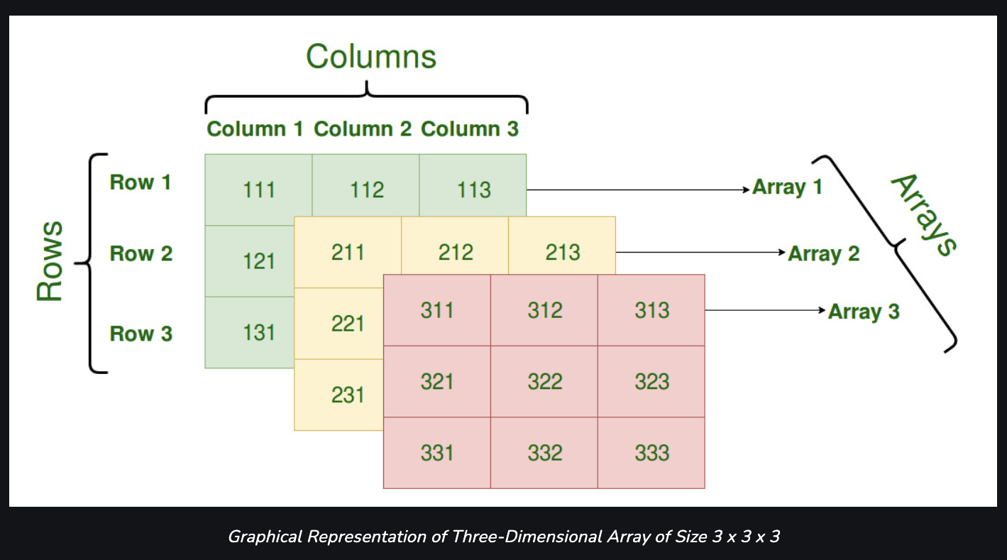
A Three Dimensional Array or 3D array in C is a collection of two-dimensional arrays.
It can be visualized as multiple 2D arrays stacked on top of each other.
We can declare a 3D array with x 2D arrays each having y rows and z columns using the syntax shown below.

Slide 11
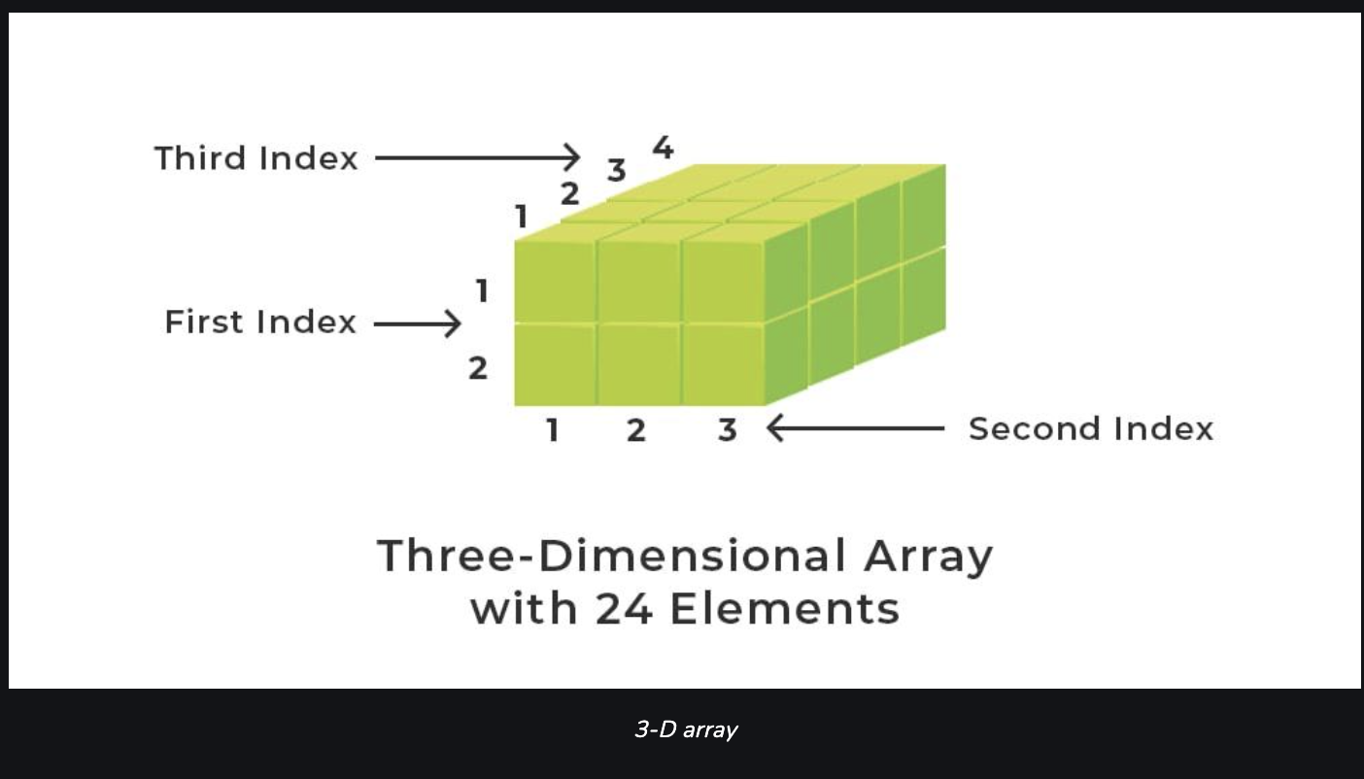

Slide 12
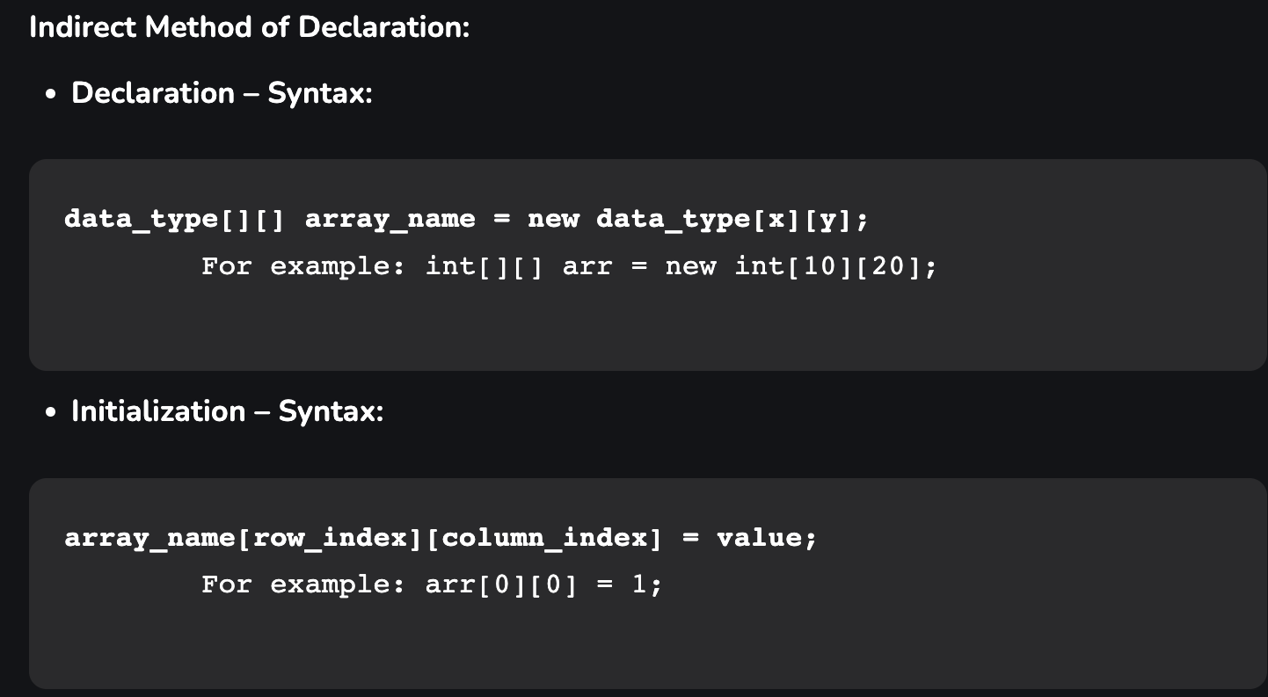

Slide 13
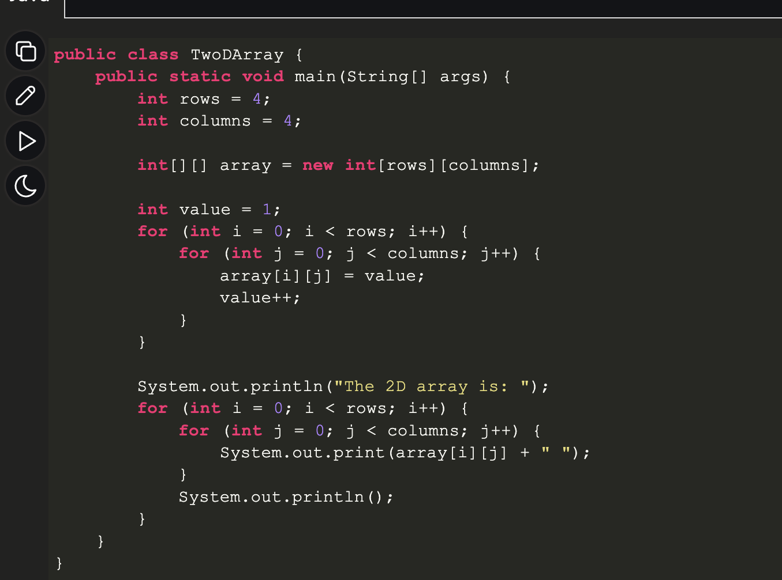

Slide 14
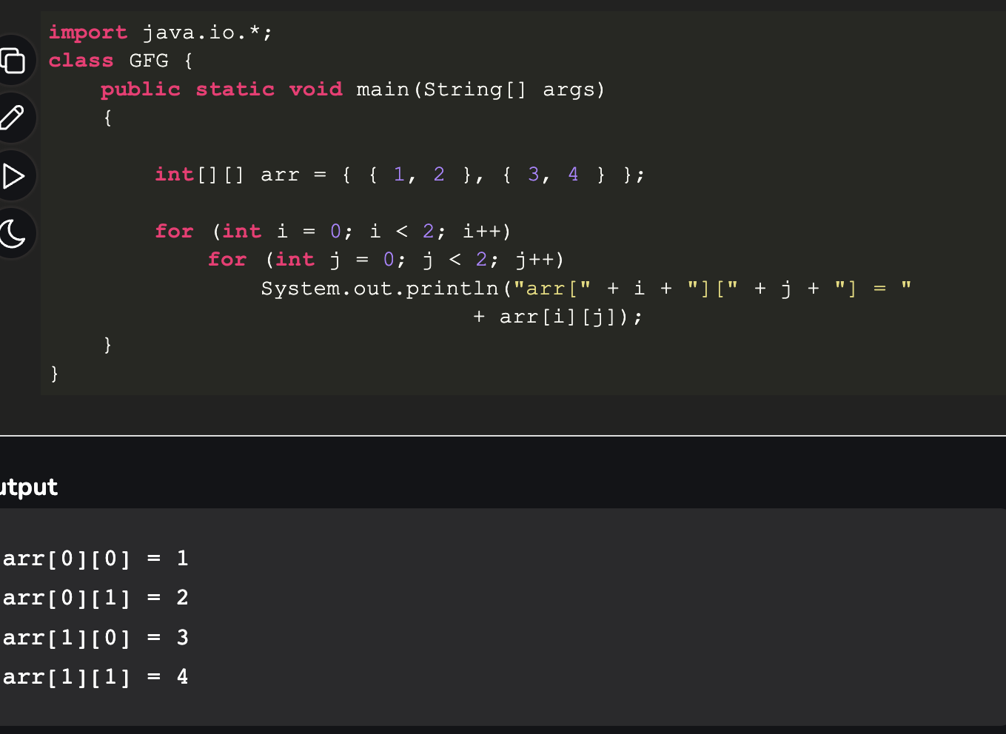

Slide 15
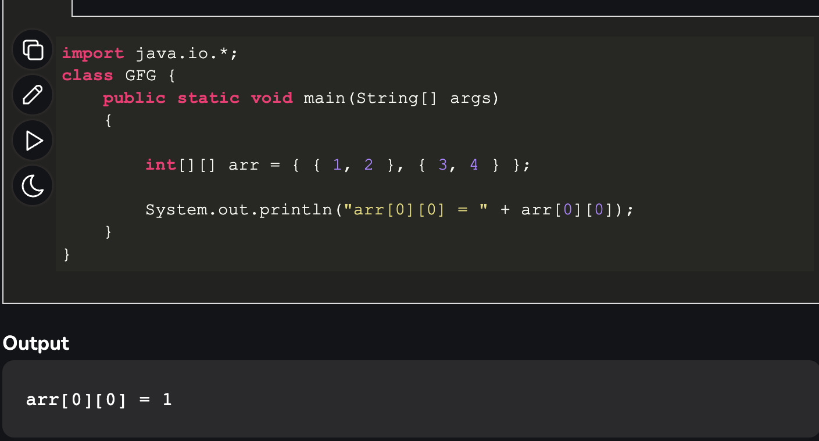

Slide 16
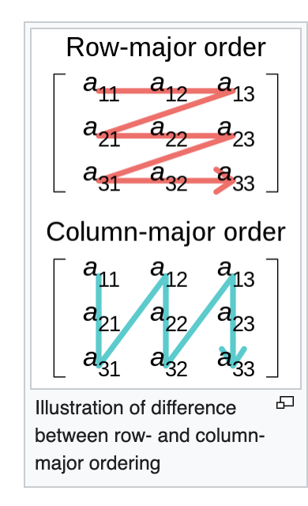
Row- and column-major order
In row-major order, the consecutive elements of a row reside next to each other.
whereas the same holds true for consecutive elements of a column in column-major order.

Slide 17
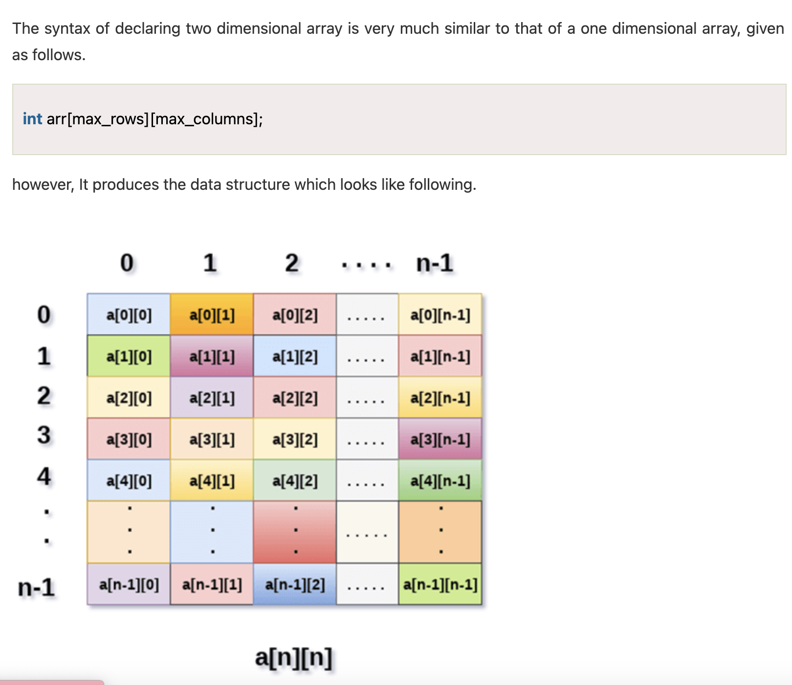

Slide 18
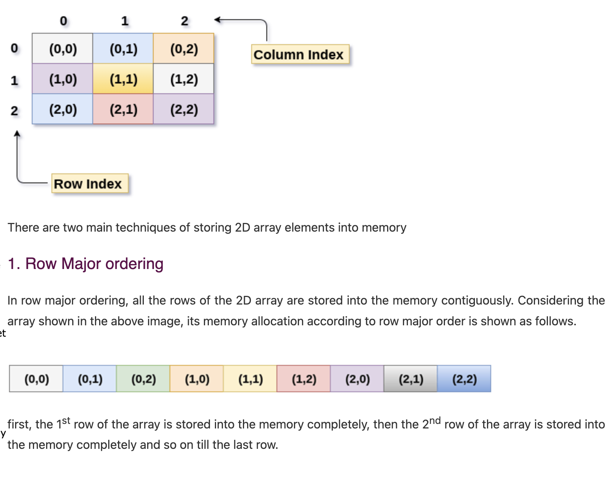

Slide 19
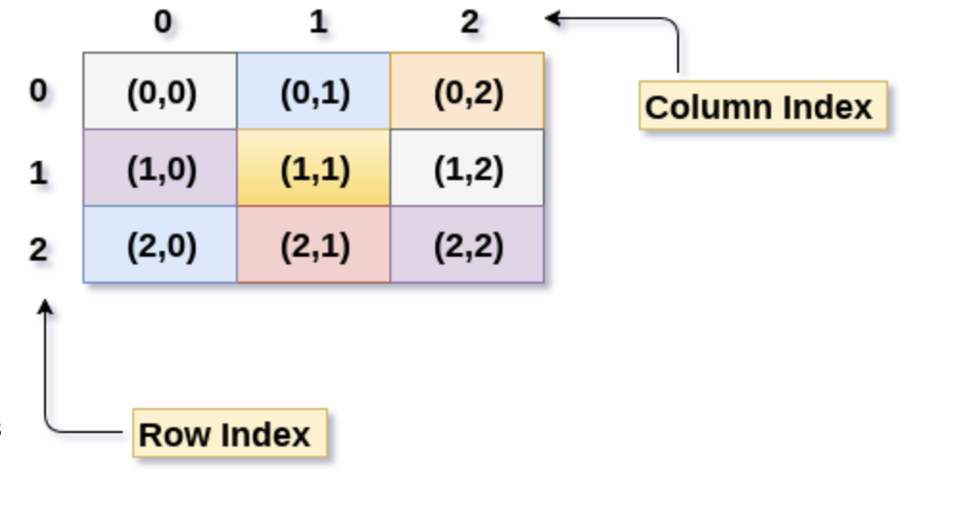
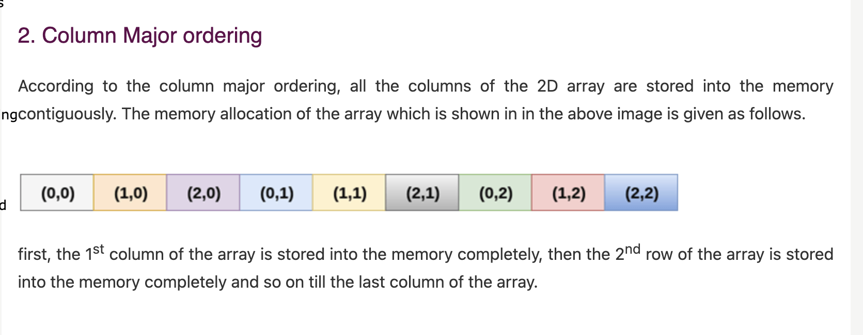

Slide 20
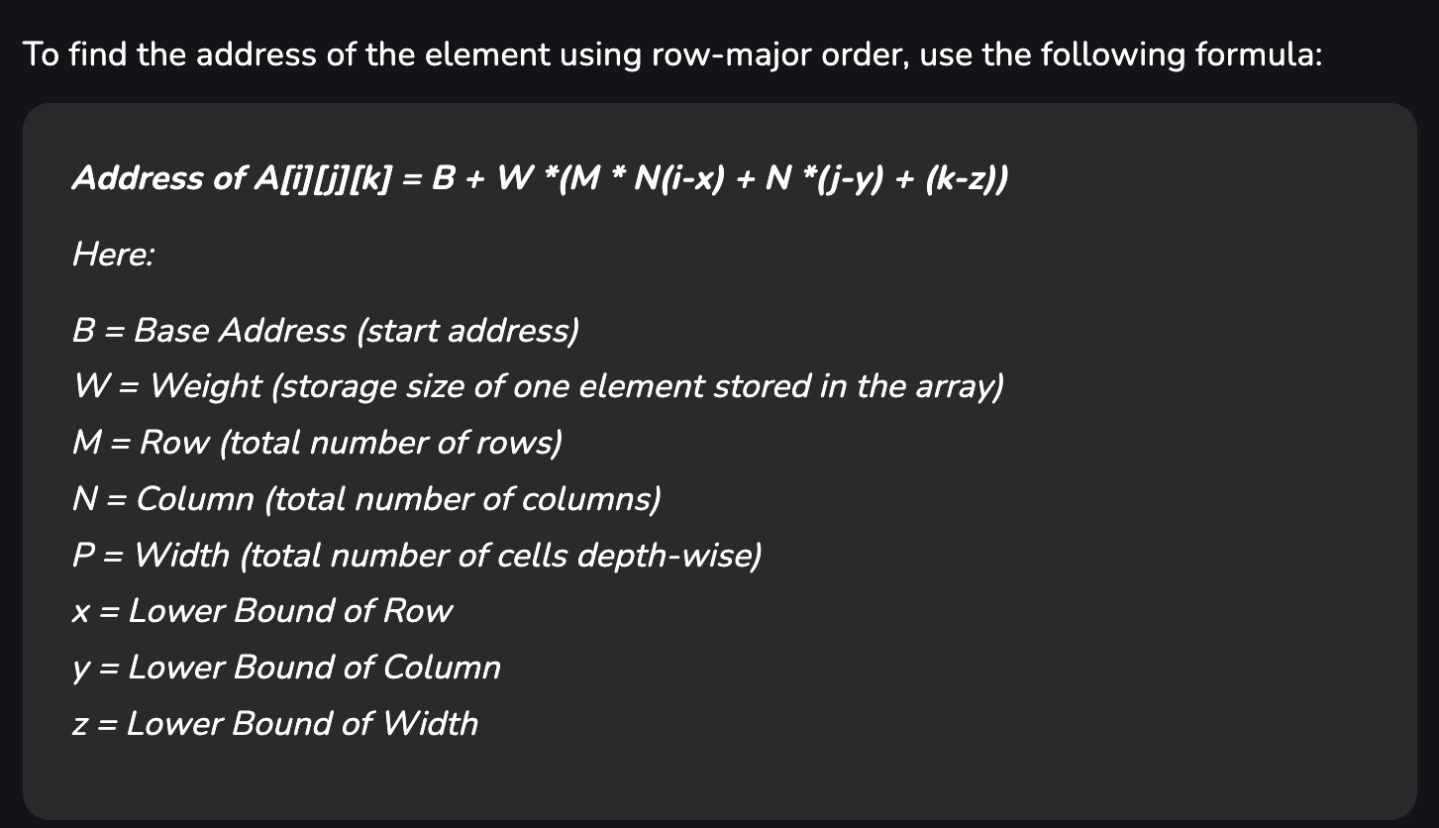

Slide 21
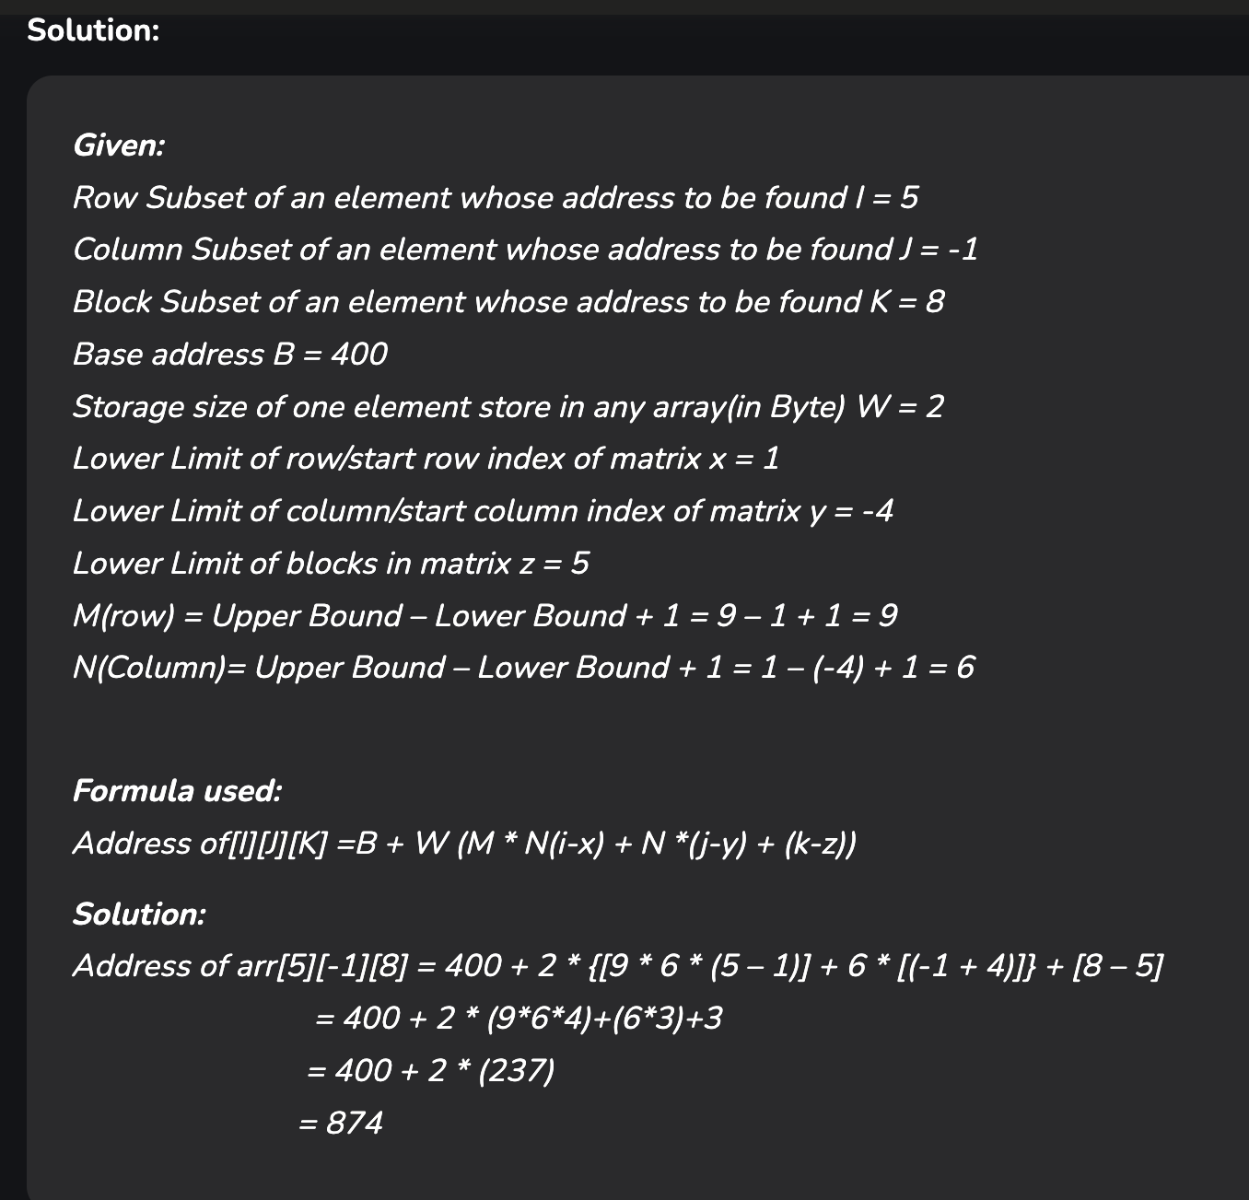
Example: Given an array, arr[1:9, -4:1, 5:10] with a base value of 400 and the size of each element is 2 Bytes in memory find the address of element arr[5][-1][8] with the help of row-major order?

Slide 22
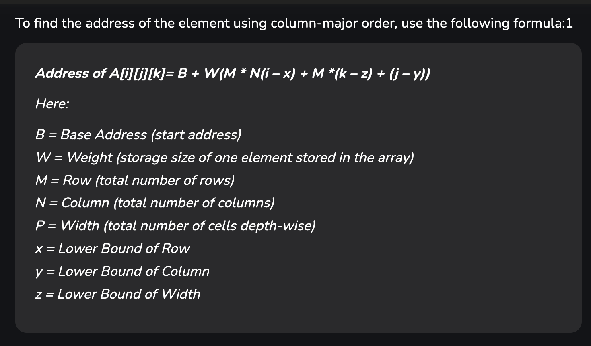

Slide 23
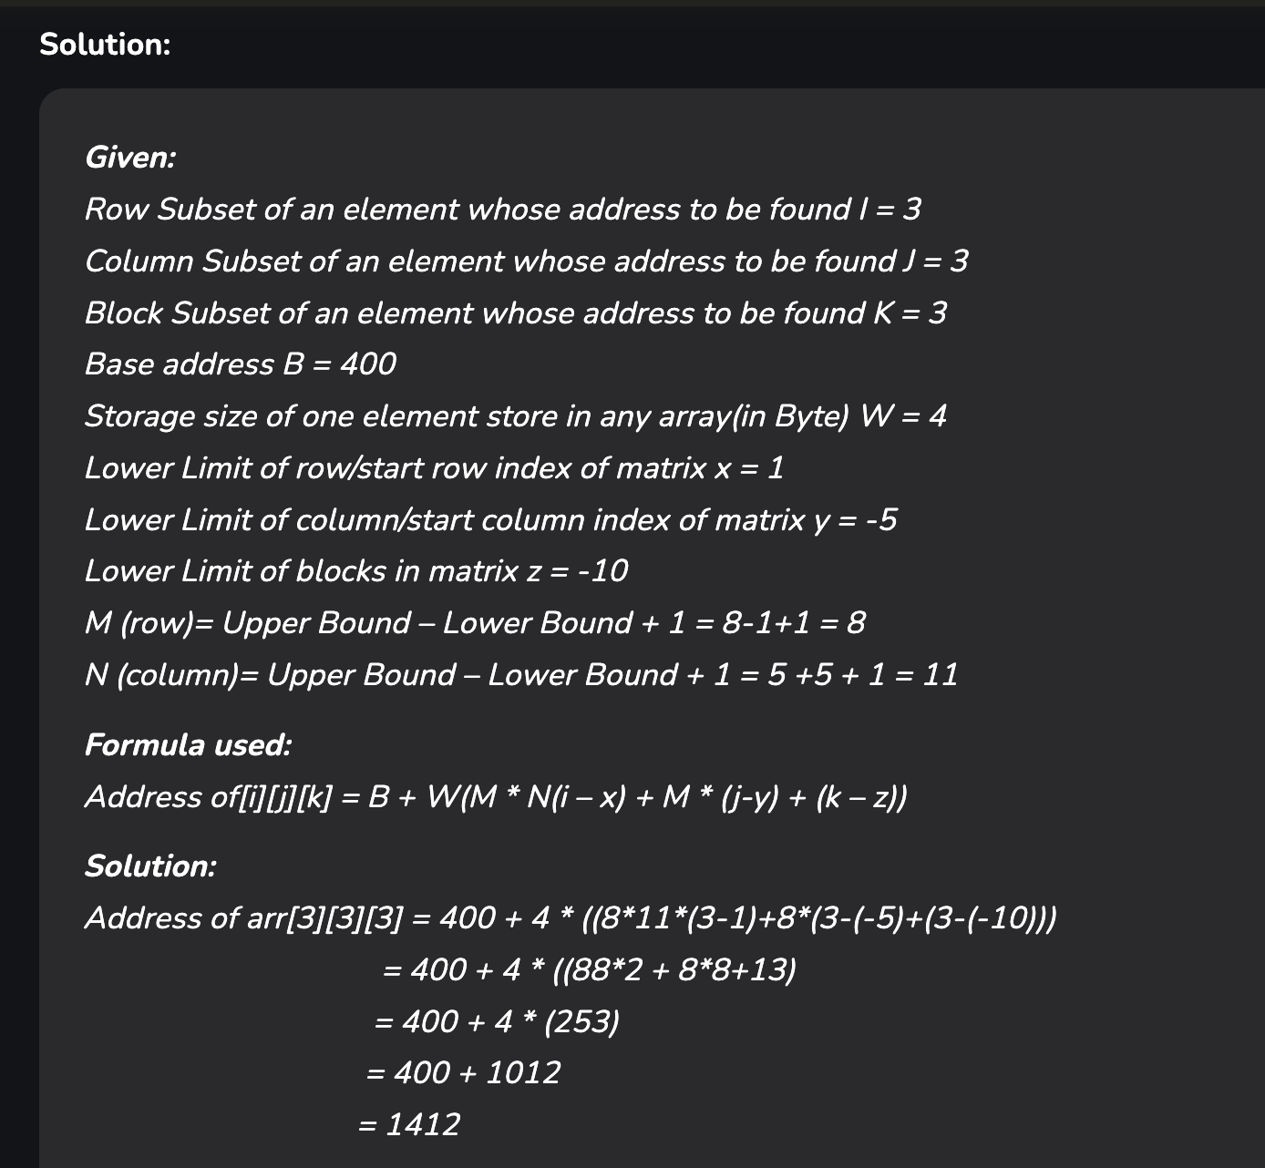
Example: Given an array arr[1:8, -5:5, -10:5] with a base value of 400 and the size of each element is 4 Bytes in memory find the address of element arr[3][3][3] with the help of column-major order?

Slide 24
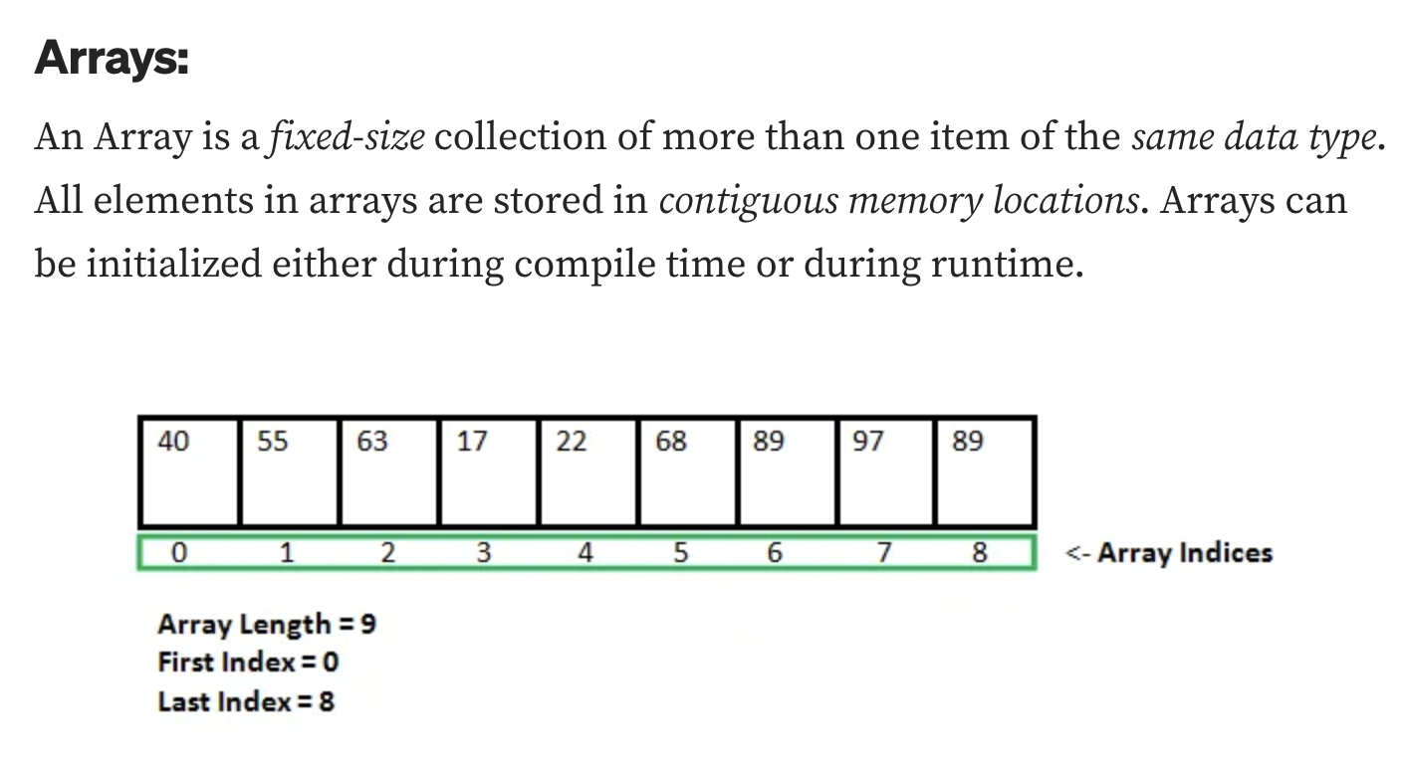
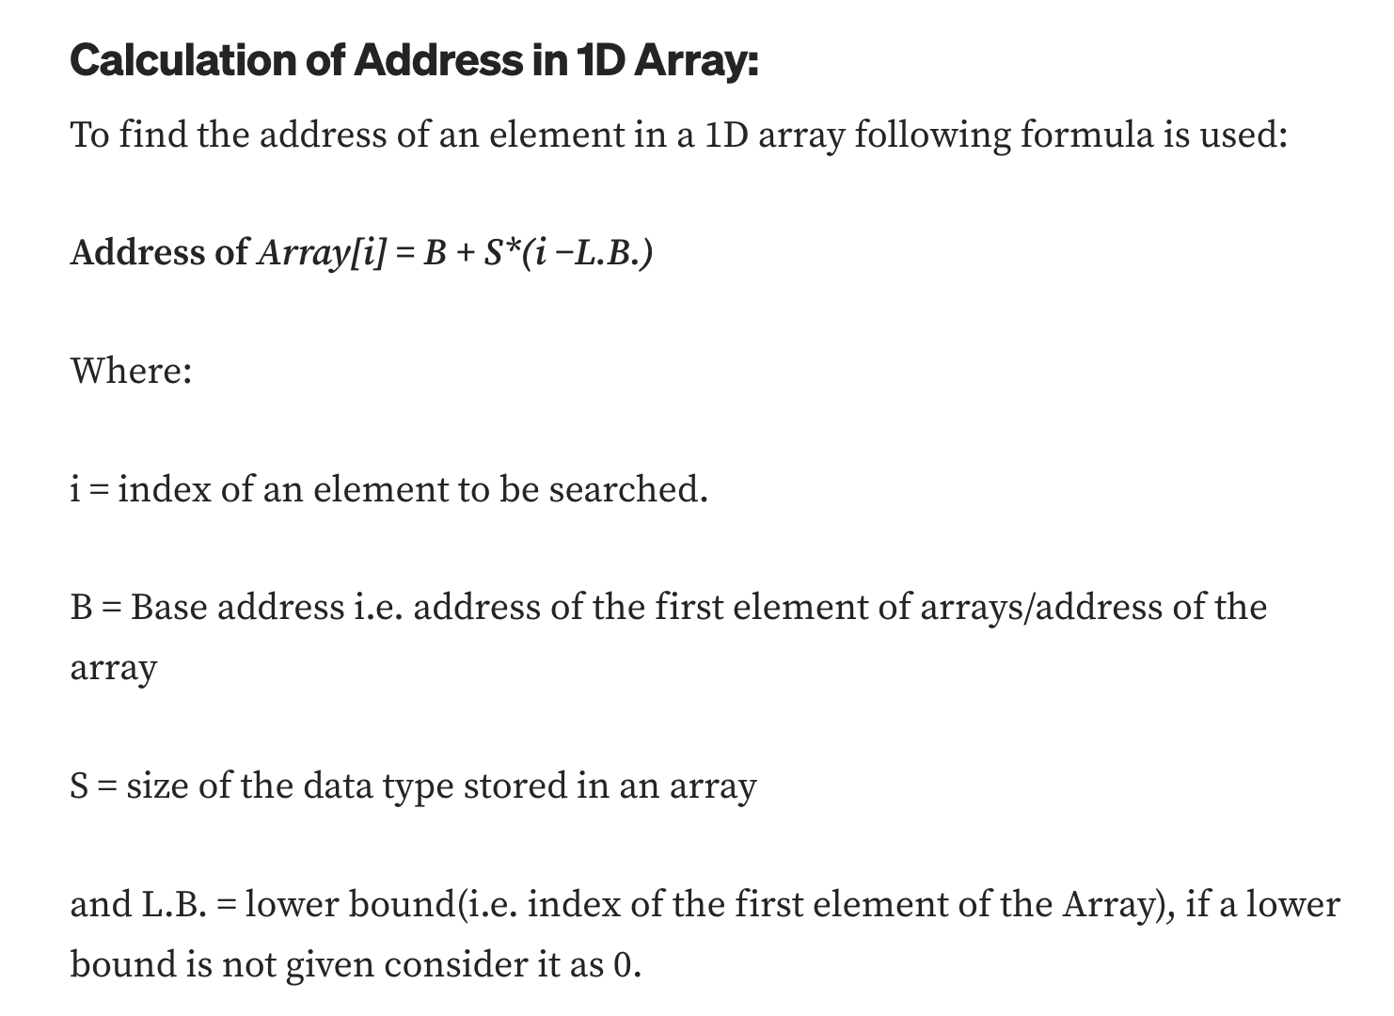

Slide 25
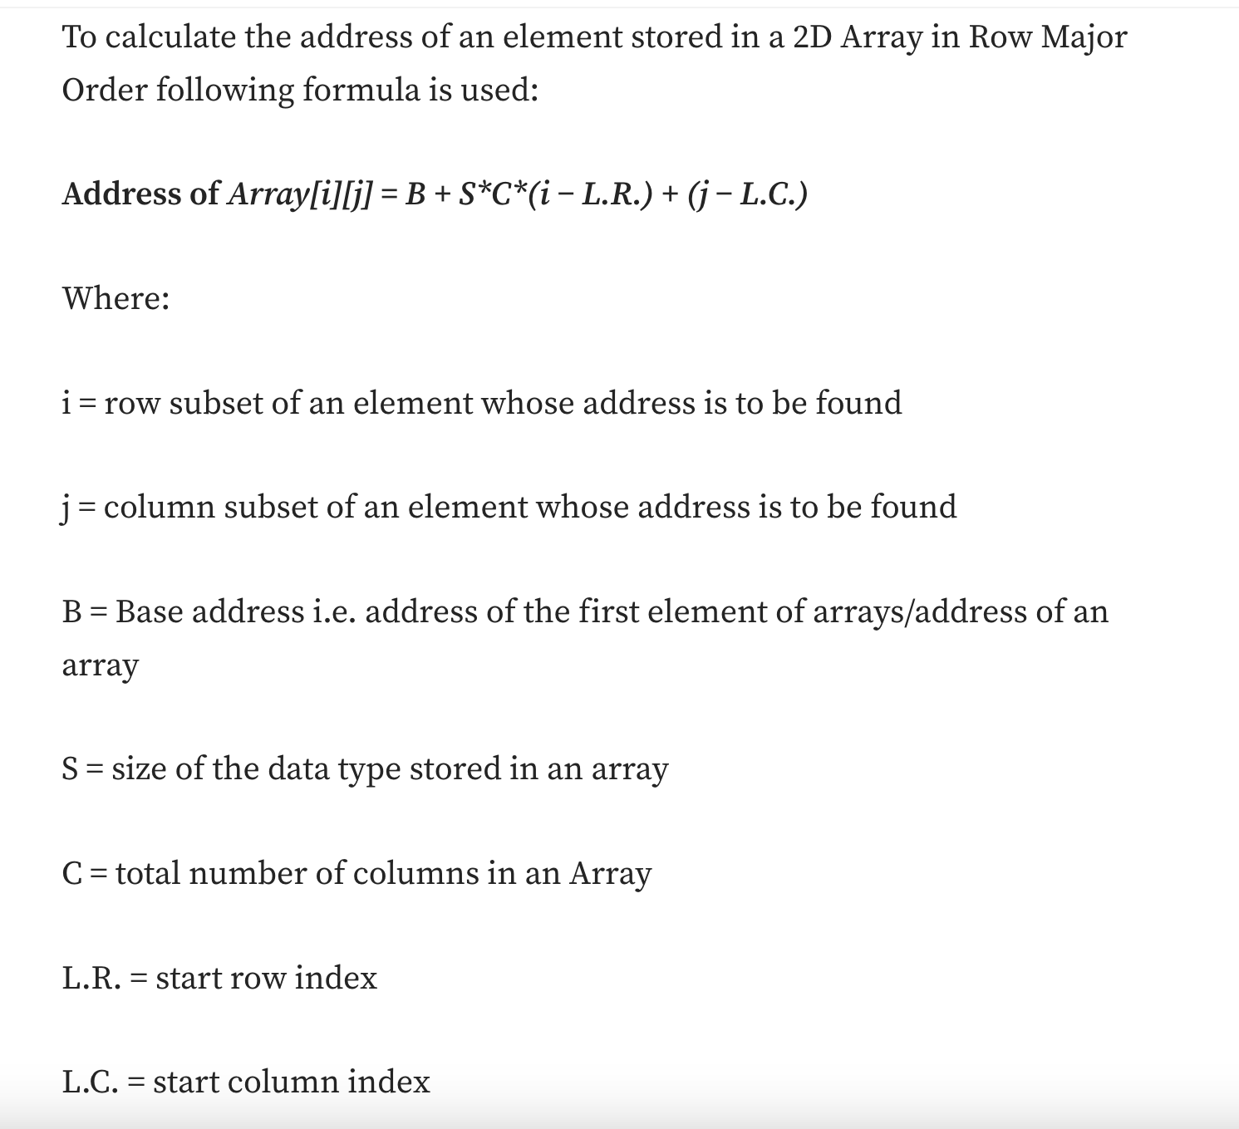
Row Major Order

Slide 26
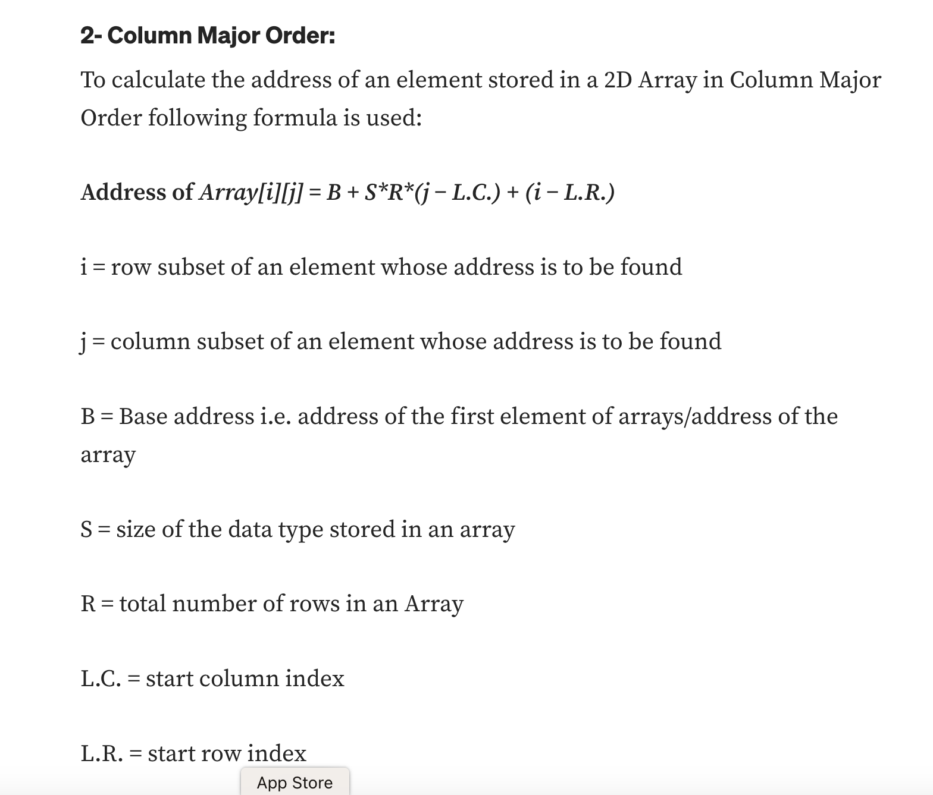

Slide 27
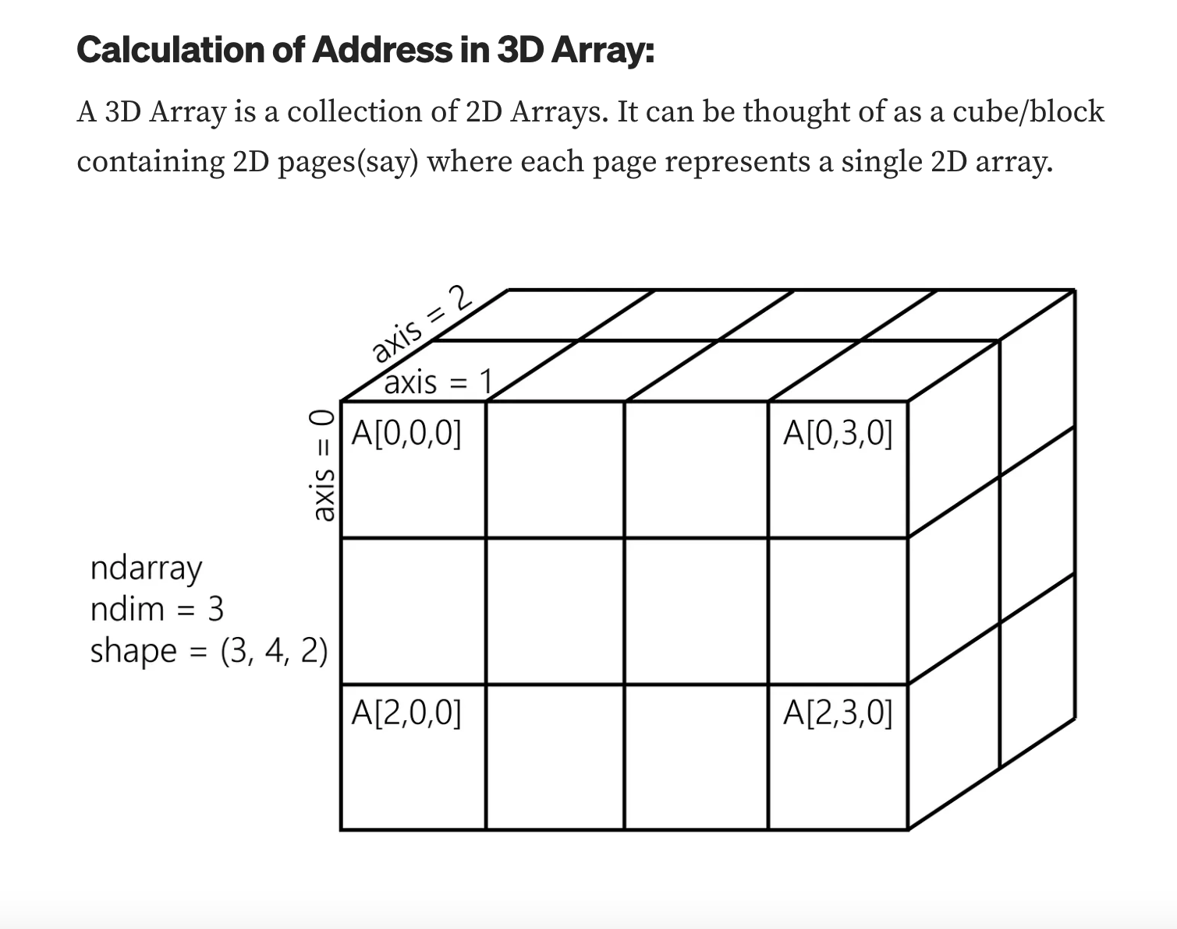
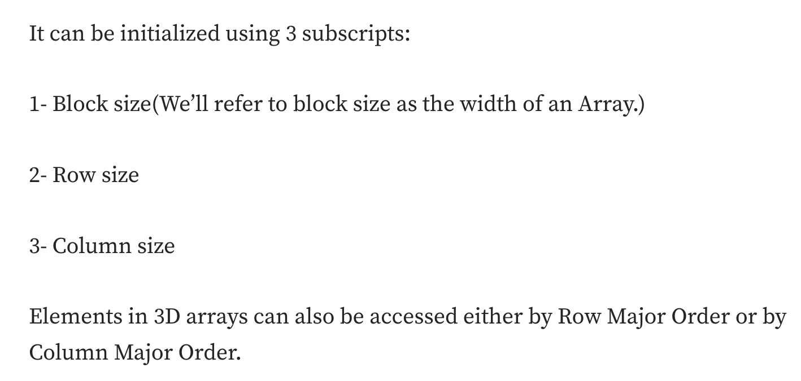

Slide 28
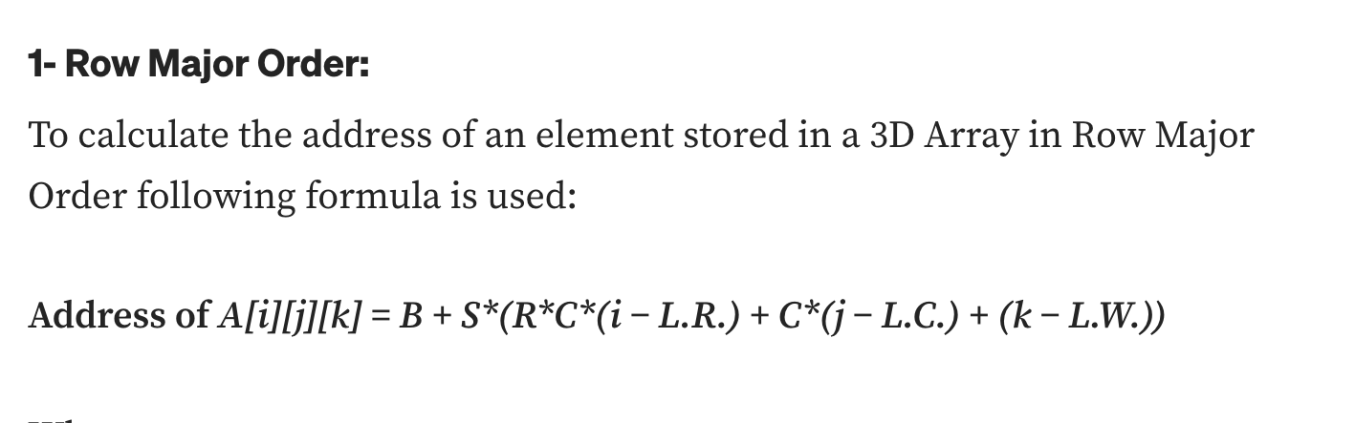
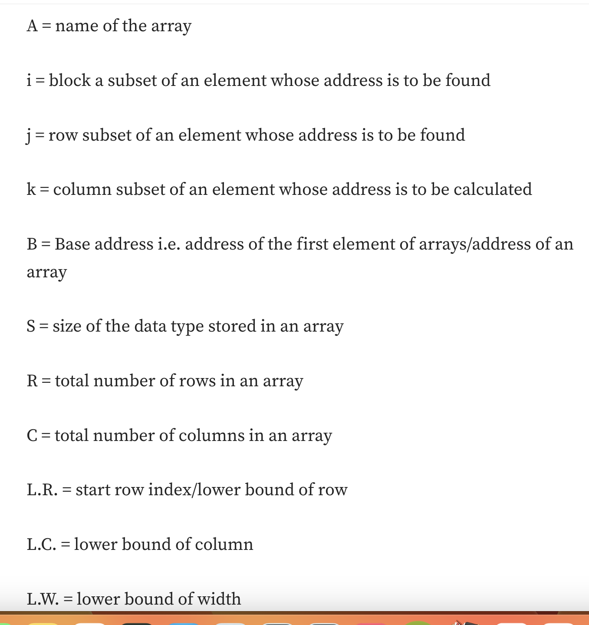

Slide 29
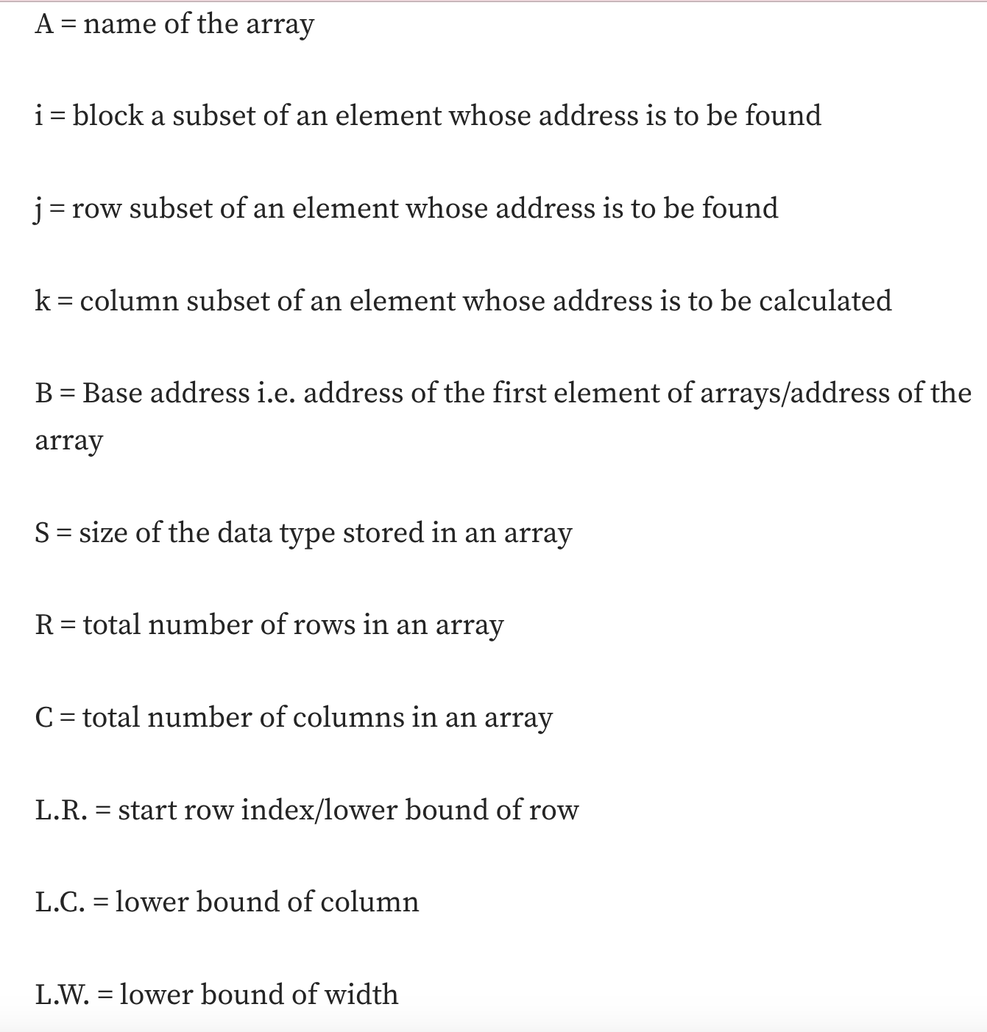
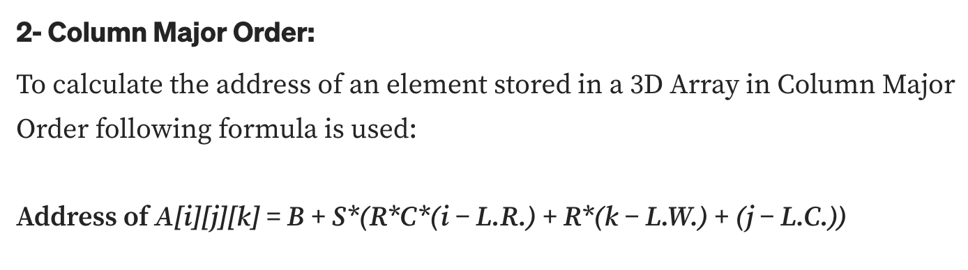

Slide 30
What is a sparse matrix?
Sparse matrices are those matrices that have the majority of their elements equal to zero.
In other words, the sparse matrix can be defined as the matrix that has a greater number of zero elements than the non-zero elements.

Slide 31
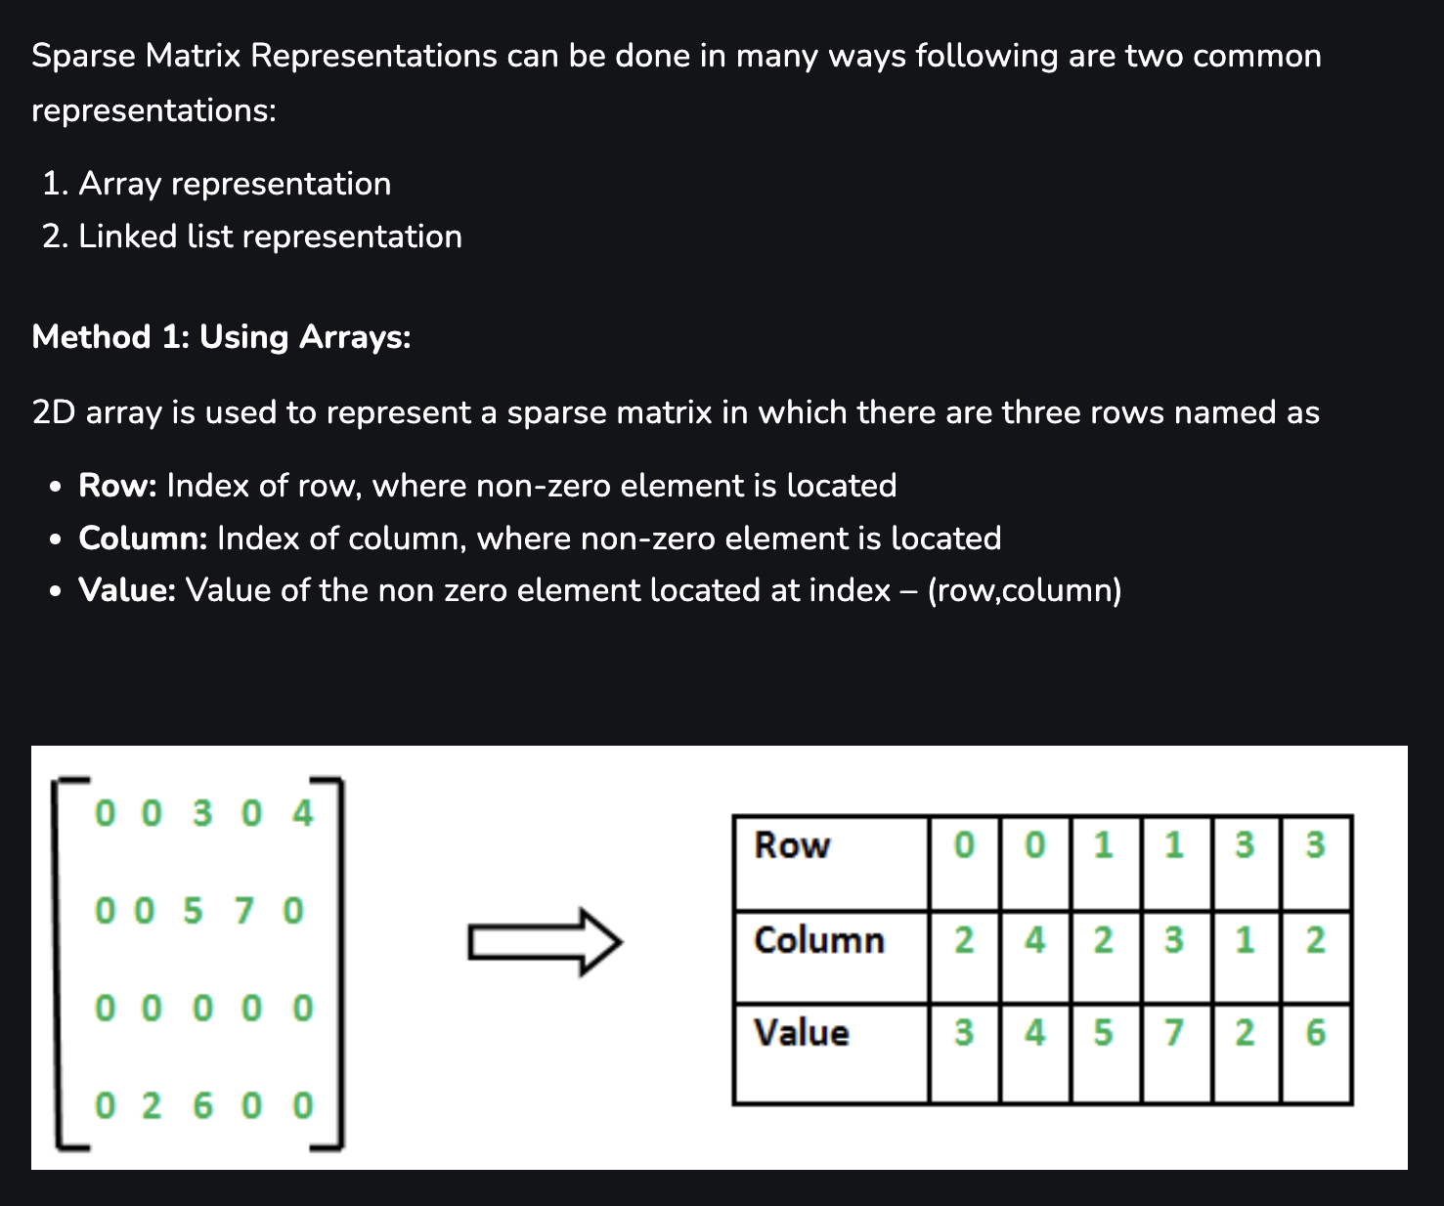

Slide 32
